Slide 1

LRZ Computing Resources for Research
19. 11.2025
Strongway

Slide 2
LRZ Infrastructure at a Glance
400GB
25PB
311,040
Free Cloud Storage per User
Data Science Storage Capacity
SuperMUC-NG Compute Cores
26.9
125PB
FREE
Petaflops Peak Performance
Total Backup Capacity
For Most LMU Staff & Students

Slide 3
Cloud Storage Services
Storage Tiers Available
Personal Cloud: 400GB free per user
Sync+Share: 50GB with PowerFolder
Temporary Storage: 10GB for quick exchanges
Institutional Storage: Shared department access
ISAR Cloud: 10-year archiving

Slide 4
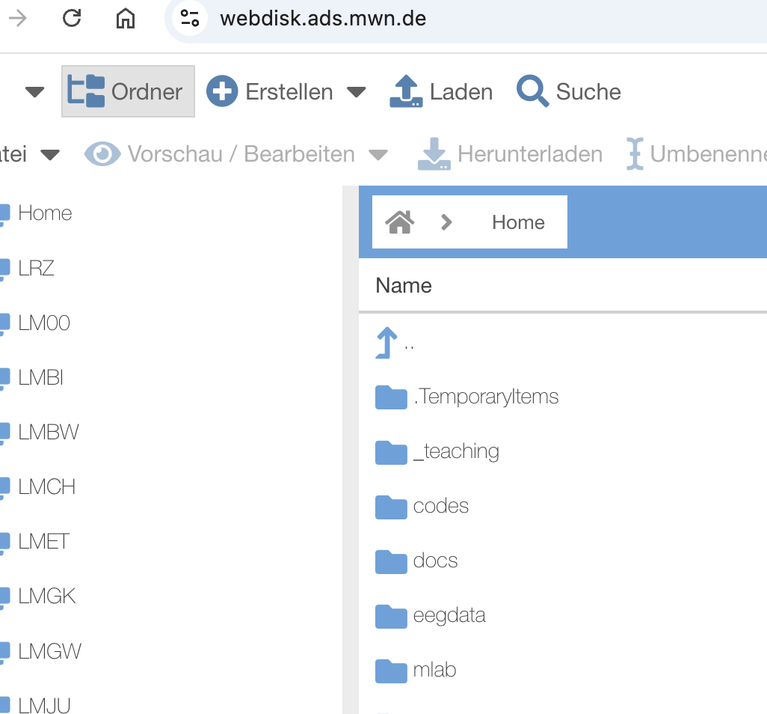
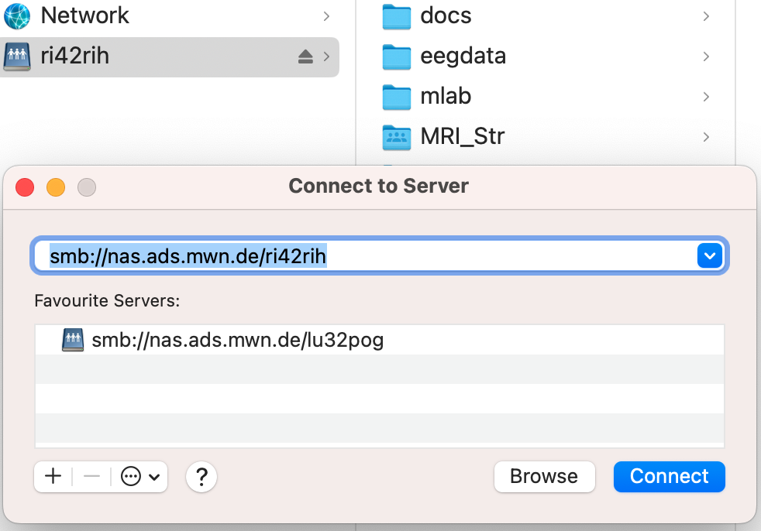
400 GB Web Disk
Web access:
https://webdisk.ads.mwn.de/
As Web Disk

Slide 5
HPC Computing Resources
Linux Cluster
12,352 cores • Intel Xeon Ice Lake & Sapphire Rapids
First-come-first-serve • No budget limits
SuperMUC-NG
311,040 cores • 26.9 petaflops
Project-based allocation • Scientific merit review

Slide 6
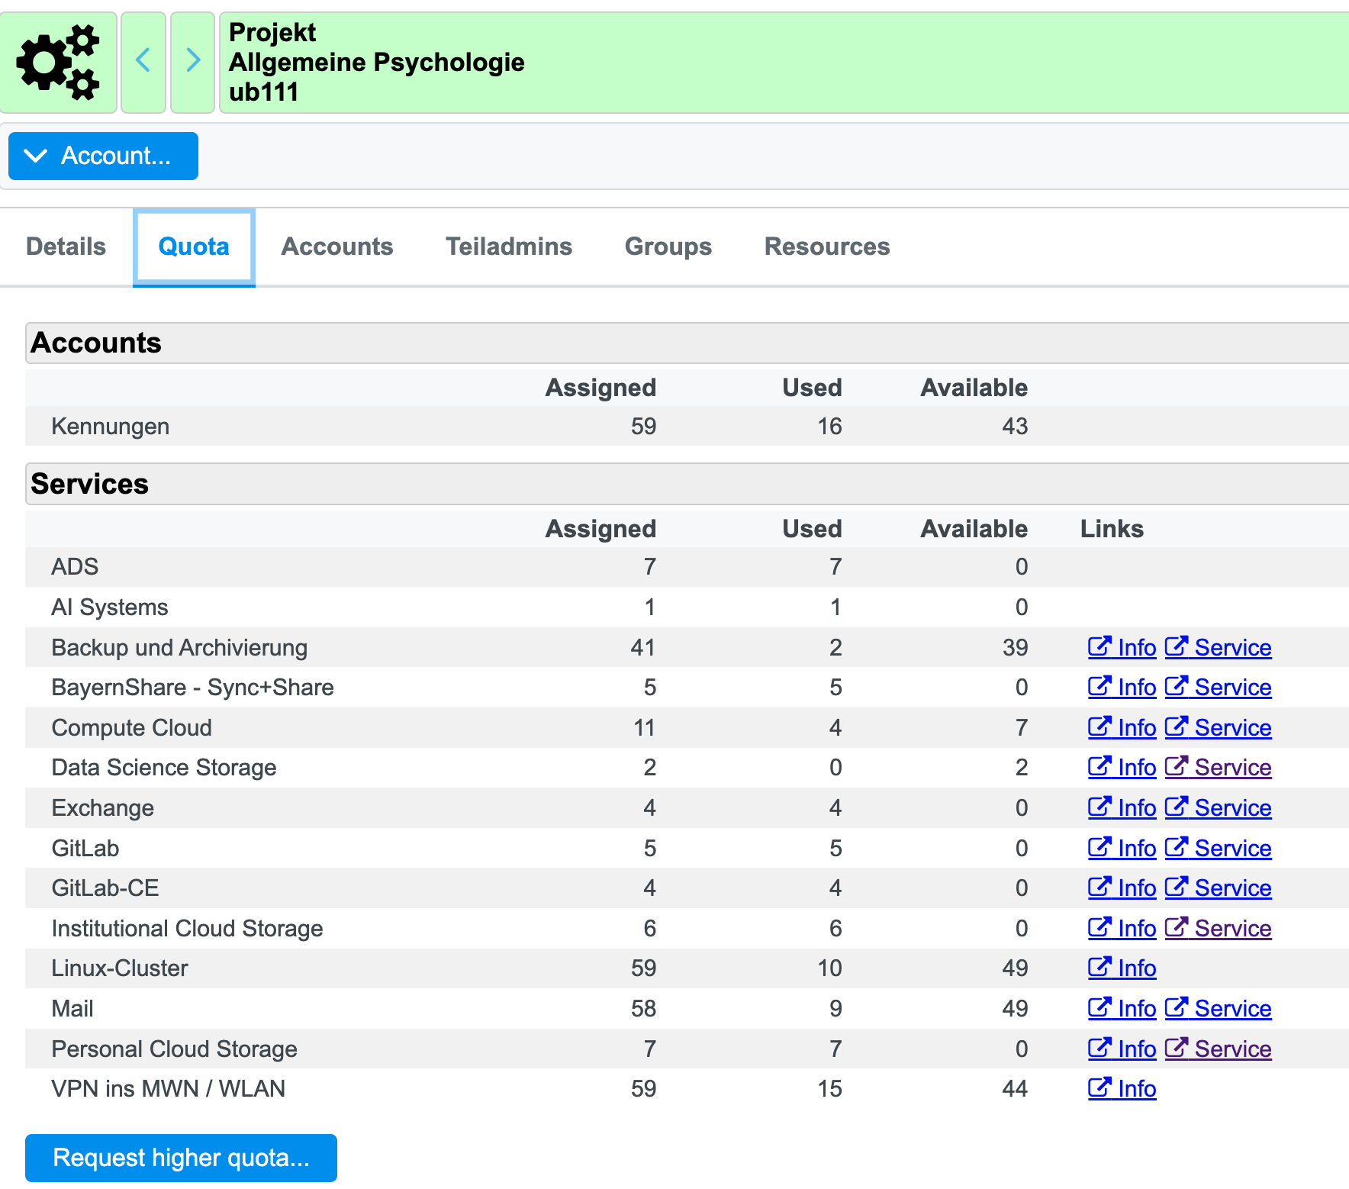
Resources available at our Chair
https://idmportal2.lrz.de/

Slide 7
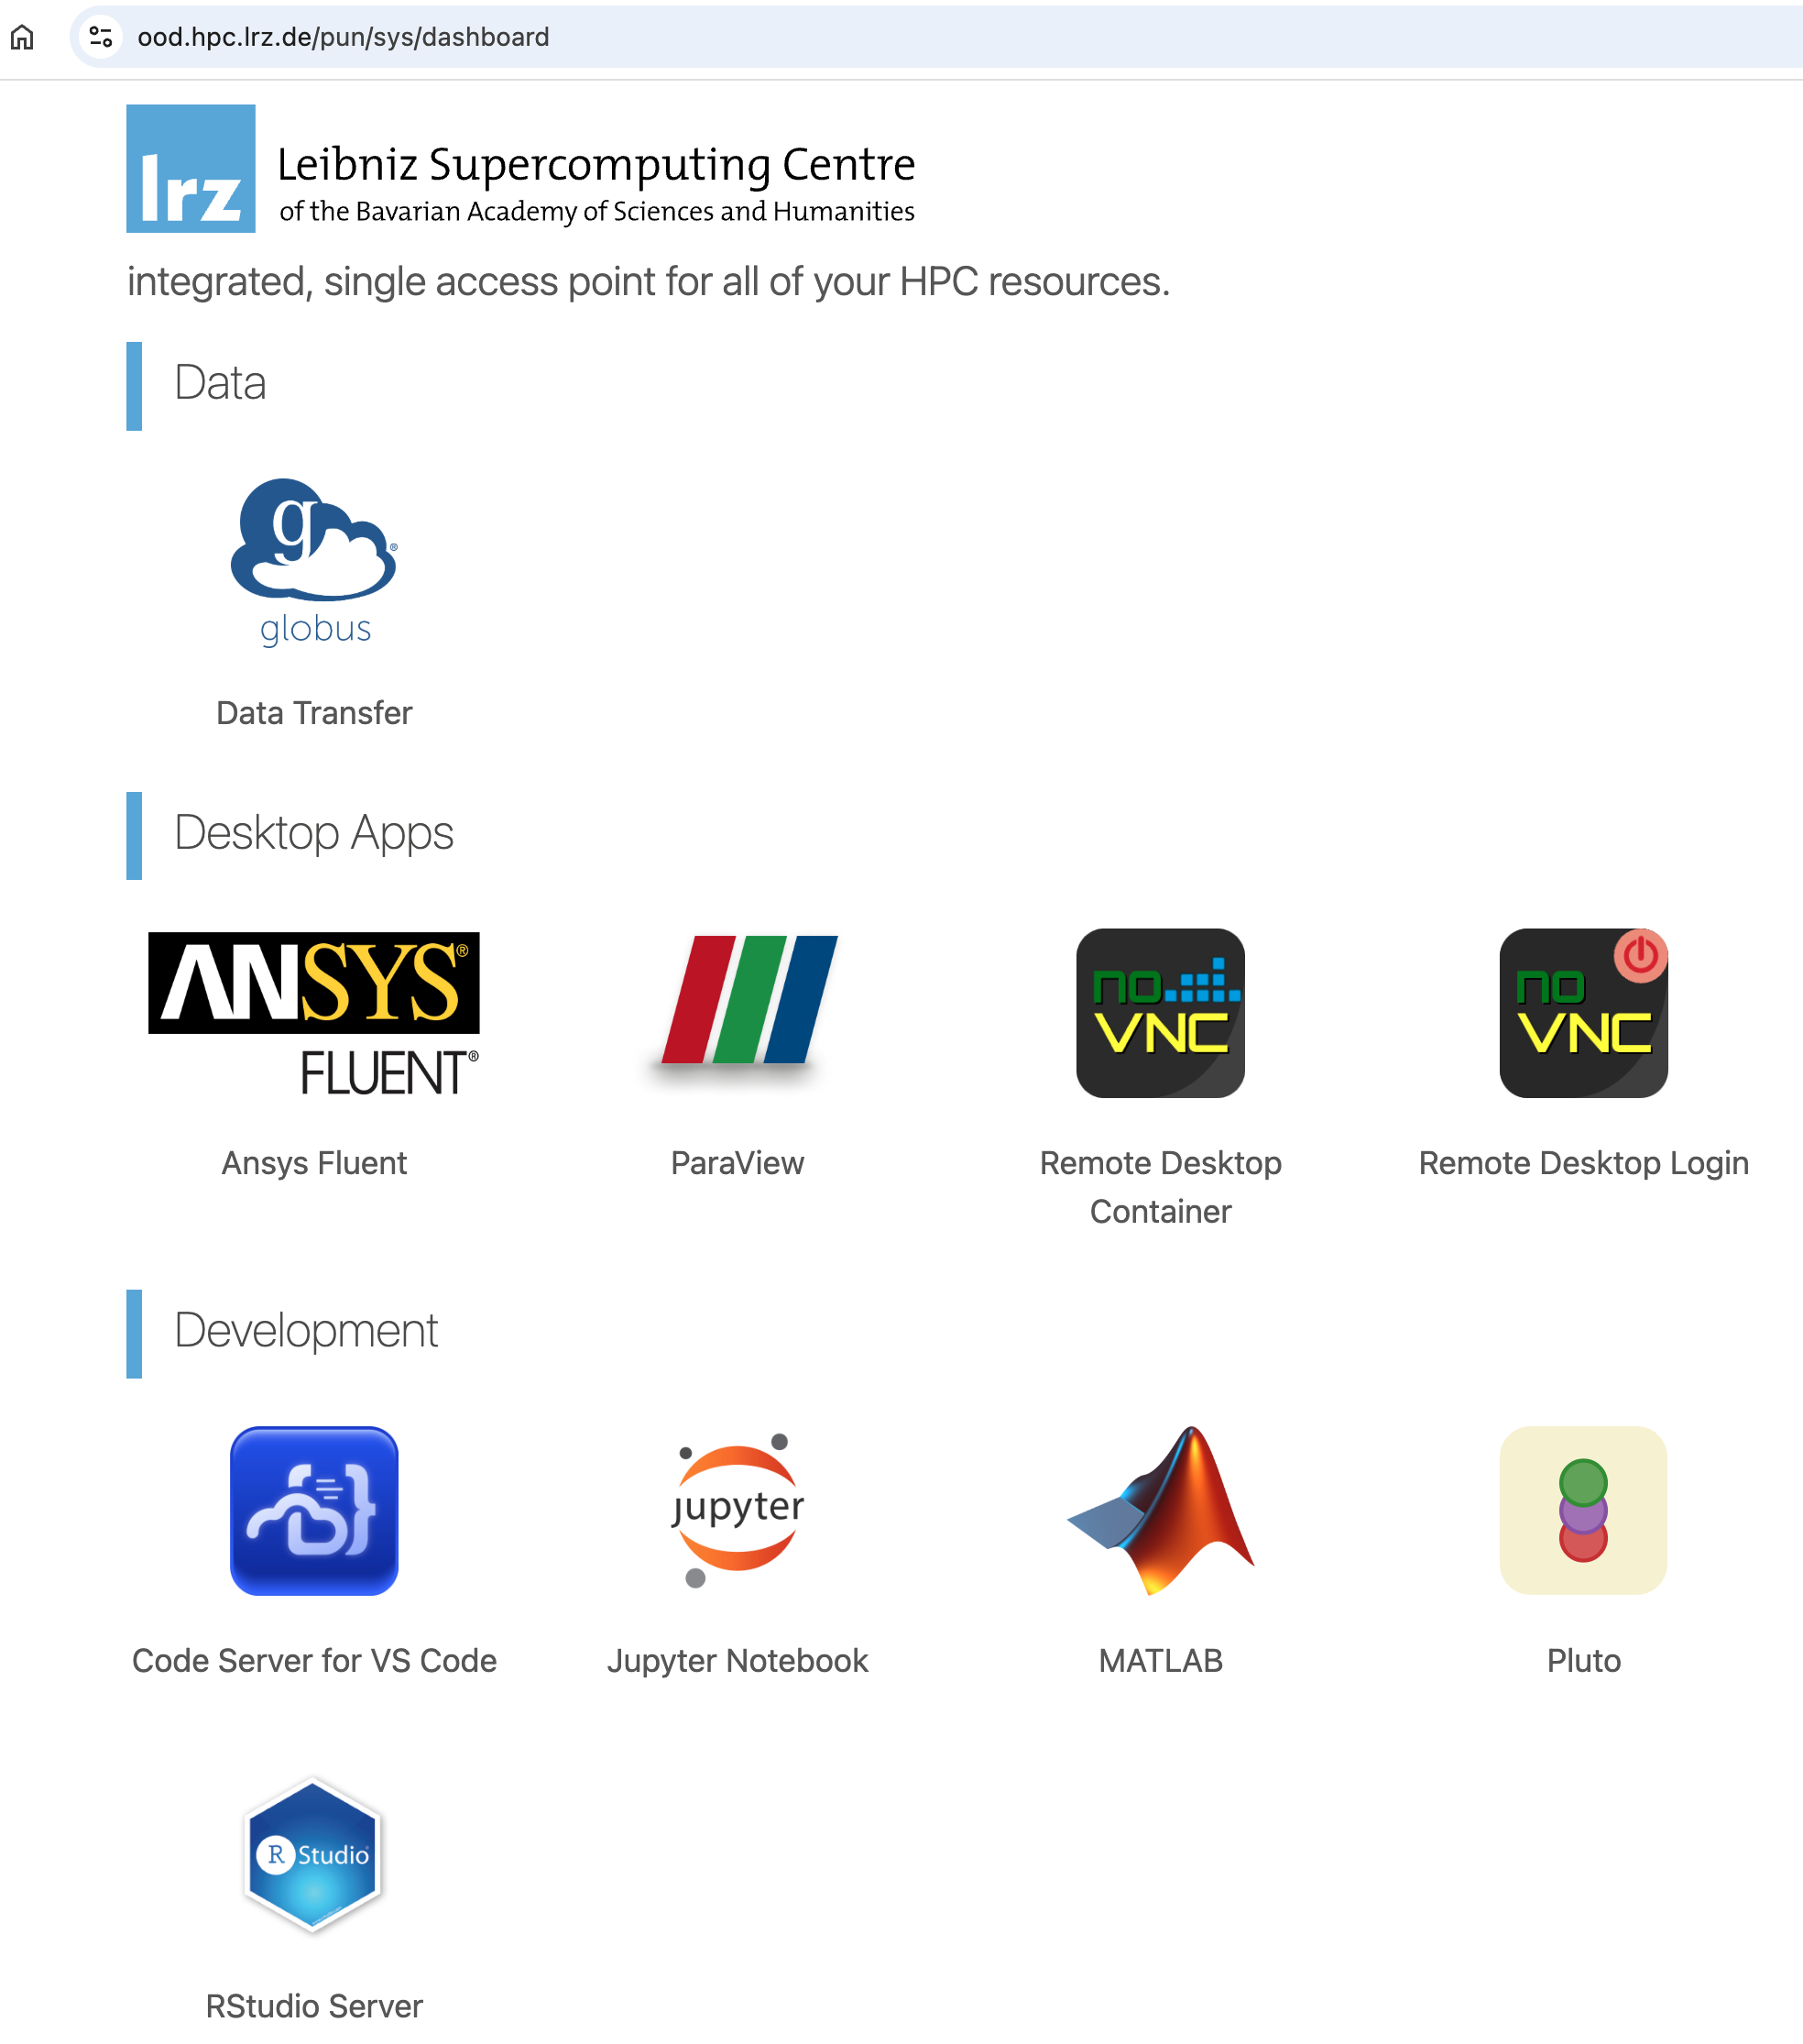
Linux Cluster (CoolMUC)
2FA login
Web access: CoolMUC Web Portal
Shell SSH

Slide 8
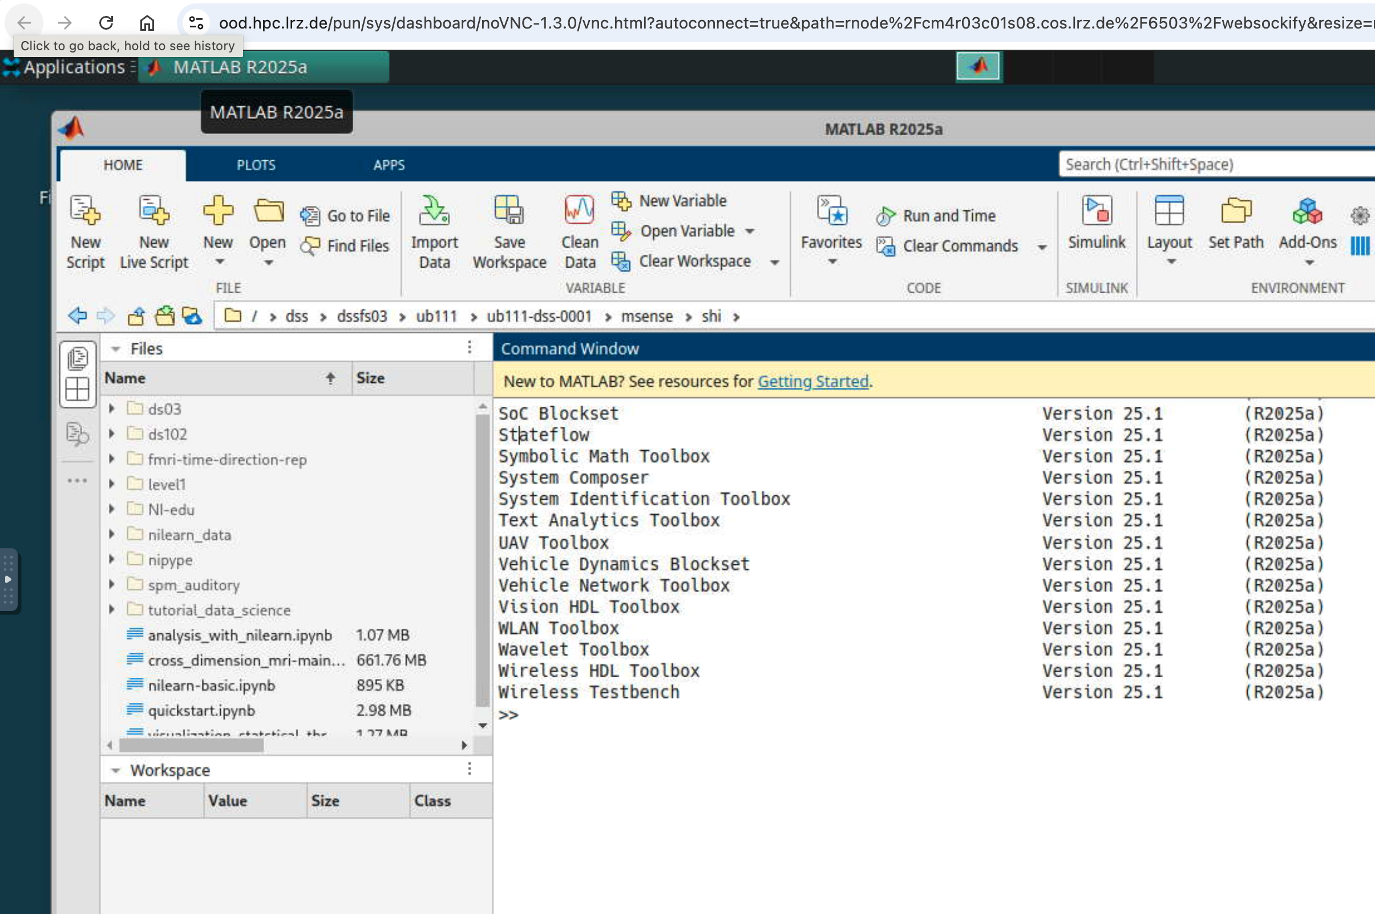
Remote Matlab via Linux Cluster

Slide 9
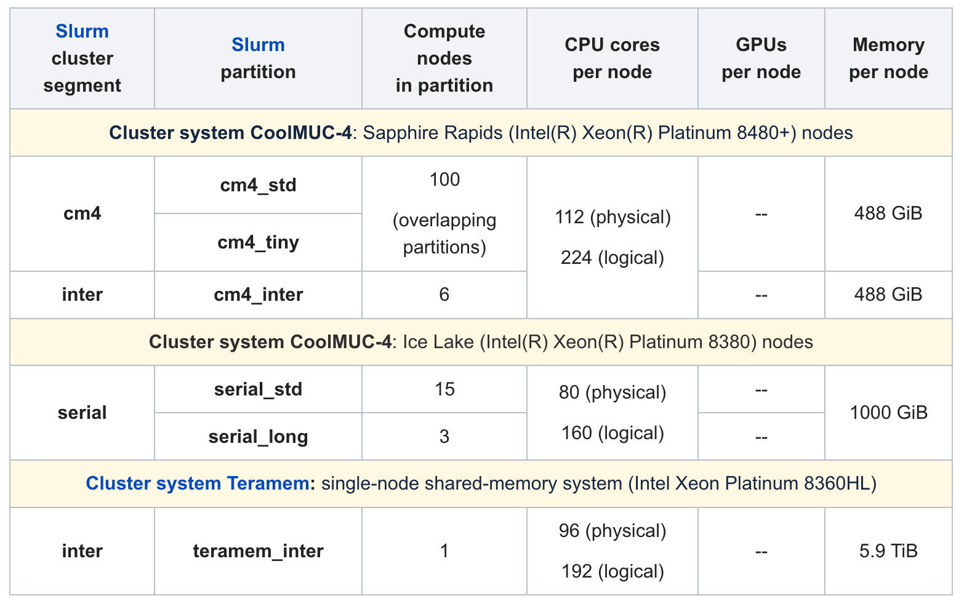
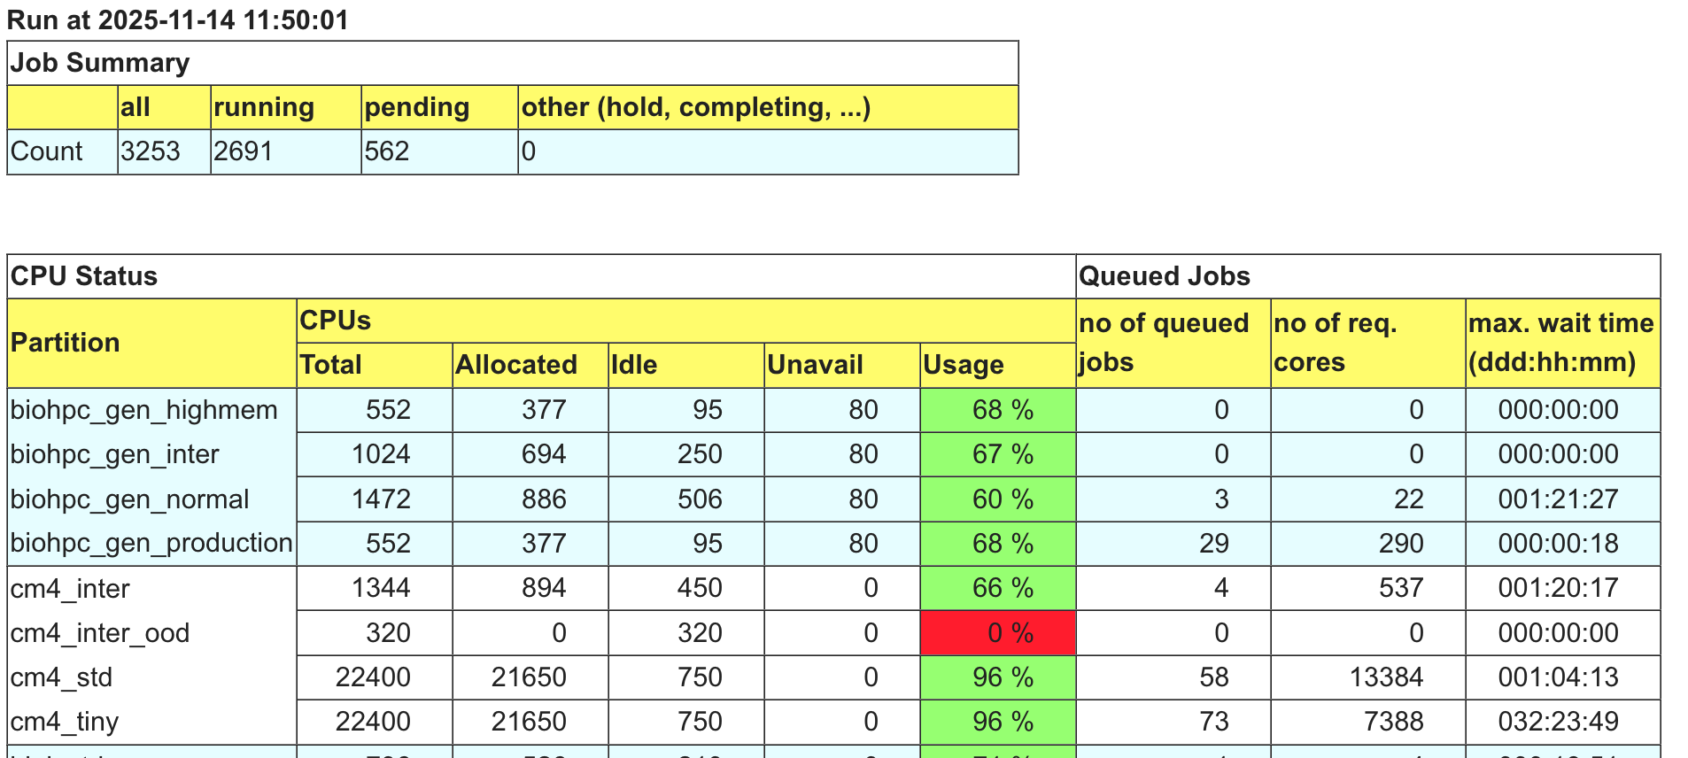
Linux Cluster: Login vs Job Processing
Do not run tasks in login node!
Allocate resource first
Interactive or SLURM
salloc -N 1 -M inter -p cm4_inter -t 2:00:00

Slide 10
Data for Computing
LRZ Sync and Share 50G ❌
Personal Cloud 400G ❌
Linux Cluster Default: 100 GB per User ✅
Data Science Storage: 20 TB ✅ (paid!)

Slide 11
Data Science Storage (DSS)
Standard Tier
AI Tier
Archive Tier
HDD-based
NVMe SSD
Tape storage
General purpose storage
Ultra-fast, low-latency
Long-term archiving
Starting at 20TB minimum
Optimized for AI/ML workloads
Two copies, separate data centers
Total Capacity: 25PB currently • Scalable to hundreds of petabytes
Access: Direct mount on all HPC systems, Compute Cloud, and remote visualization

Slide 12
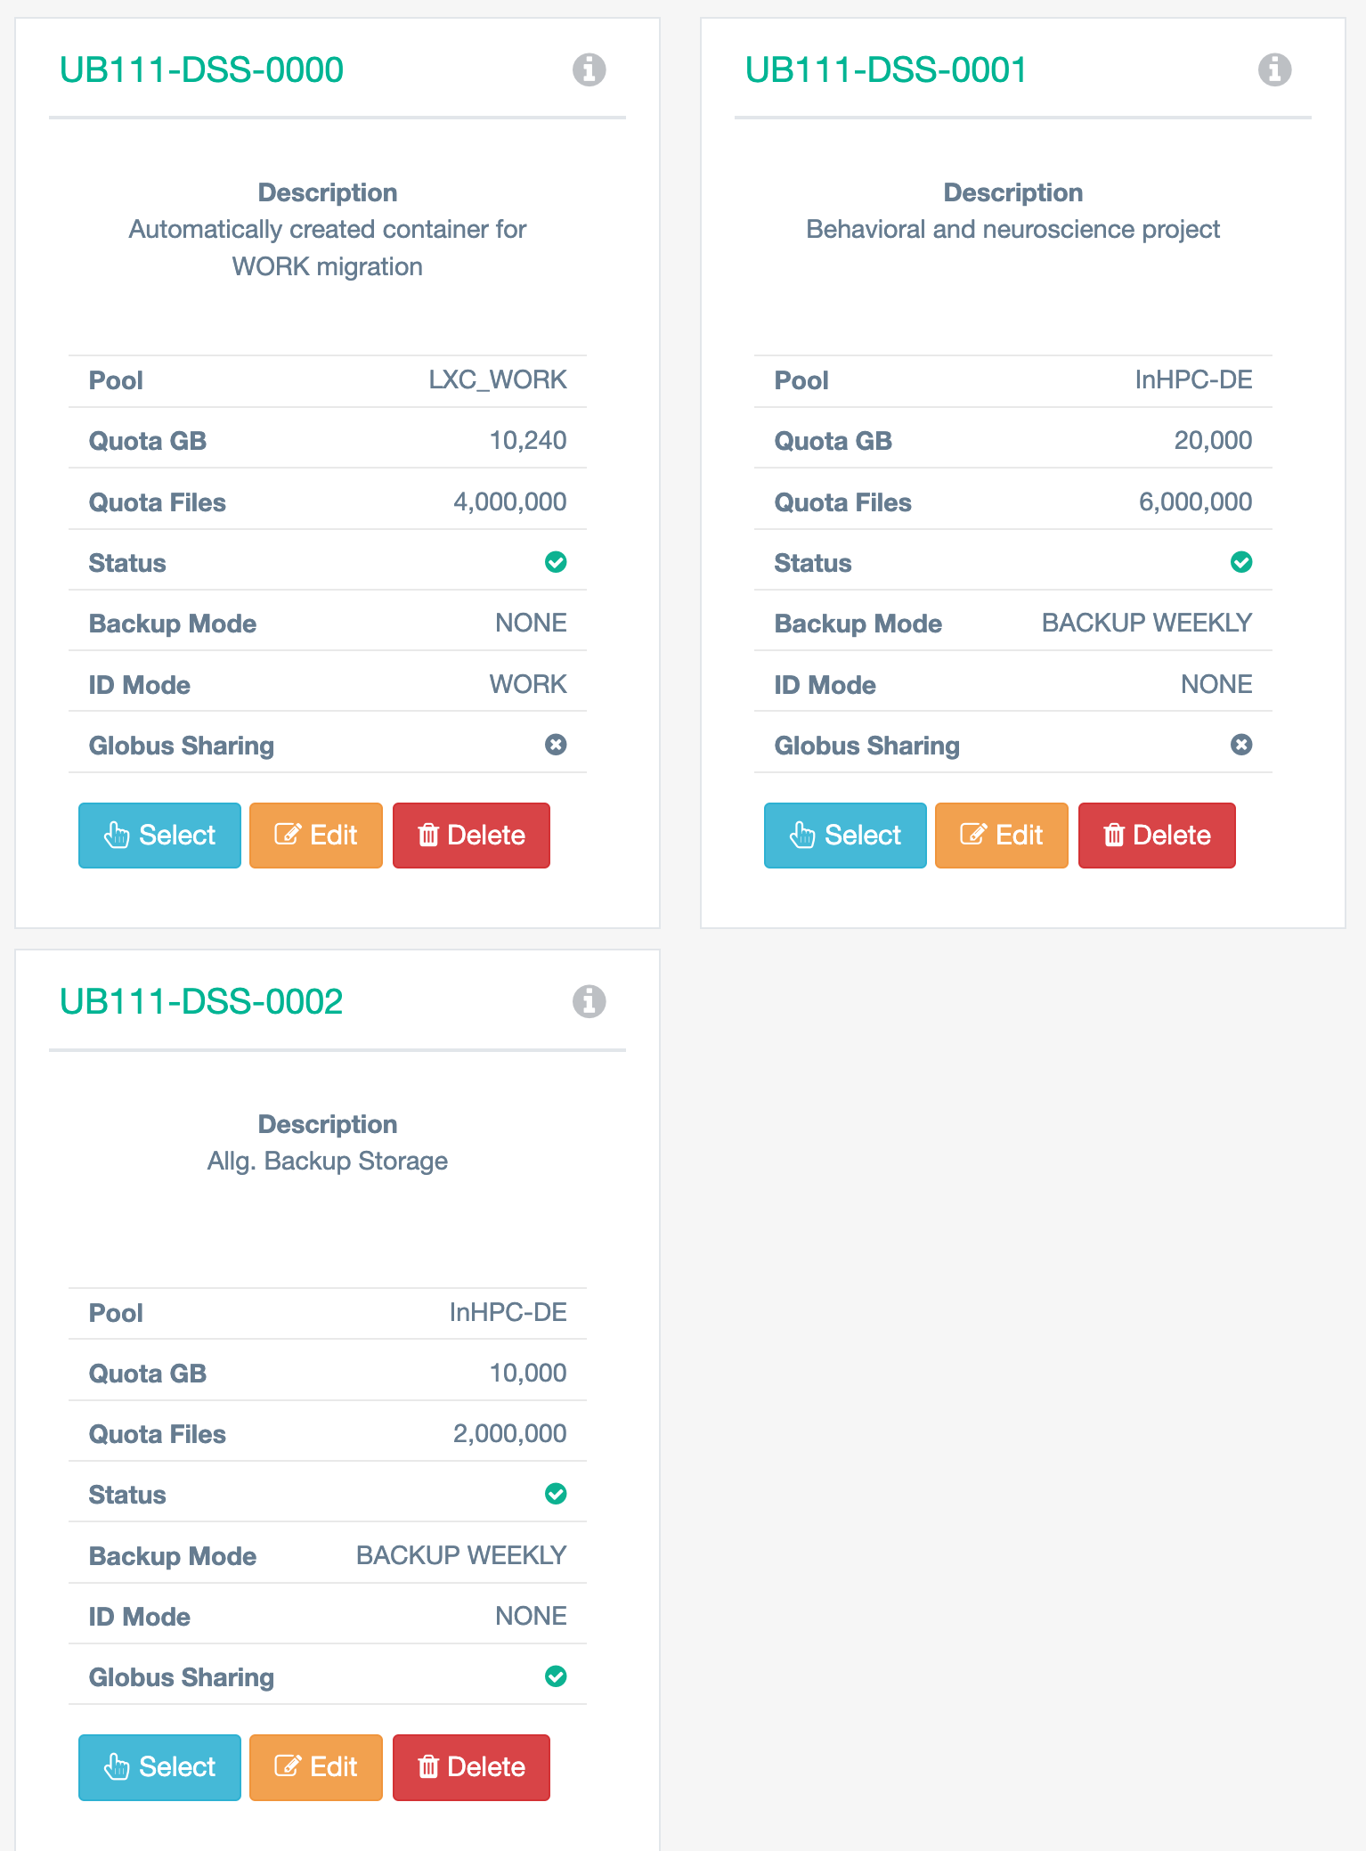
Our DSS Containers
https://dssweb.dss.lrz.de/ui/dssdatacontainer/
10 TB – Free for a cluster project
20 TB by Demand– 1800 Euro / Year

Slide 13
DDS Storage
Store vast amounts of data for as long as the data is important to you or the science community
Access this data from the whole LRZ computing ecosystem (SuperMUC-NG, LinuxCluster, Compute Cloud, AI Systems, VMWare, Remote Visualization, Housed Customer Compute Systems)
Share this data between arbitrary users of the LRZ computing ecosystem
Access/Transfer this data world wide via a high performance, WAN optimized transfer protocol, using a simple Graphical User Interface in the Web
Share this data with arbitrary users around the globe, like you are already used to from services like LRZ Sync+Share, Dropbox or Google Drive

Slide 14
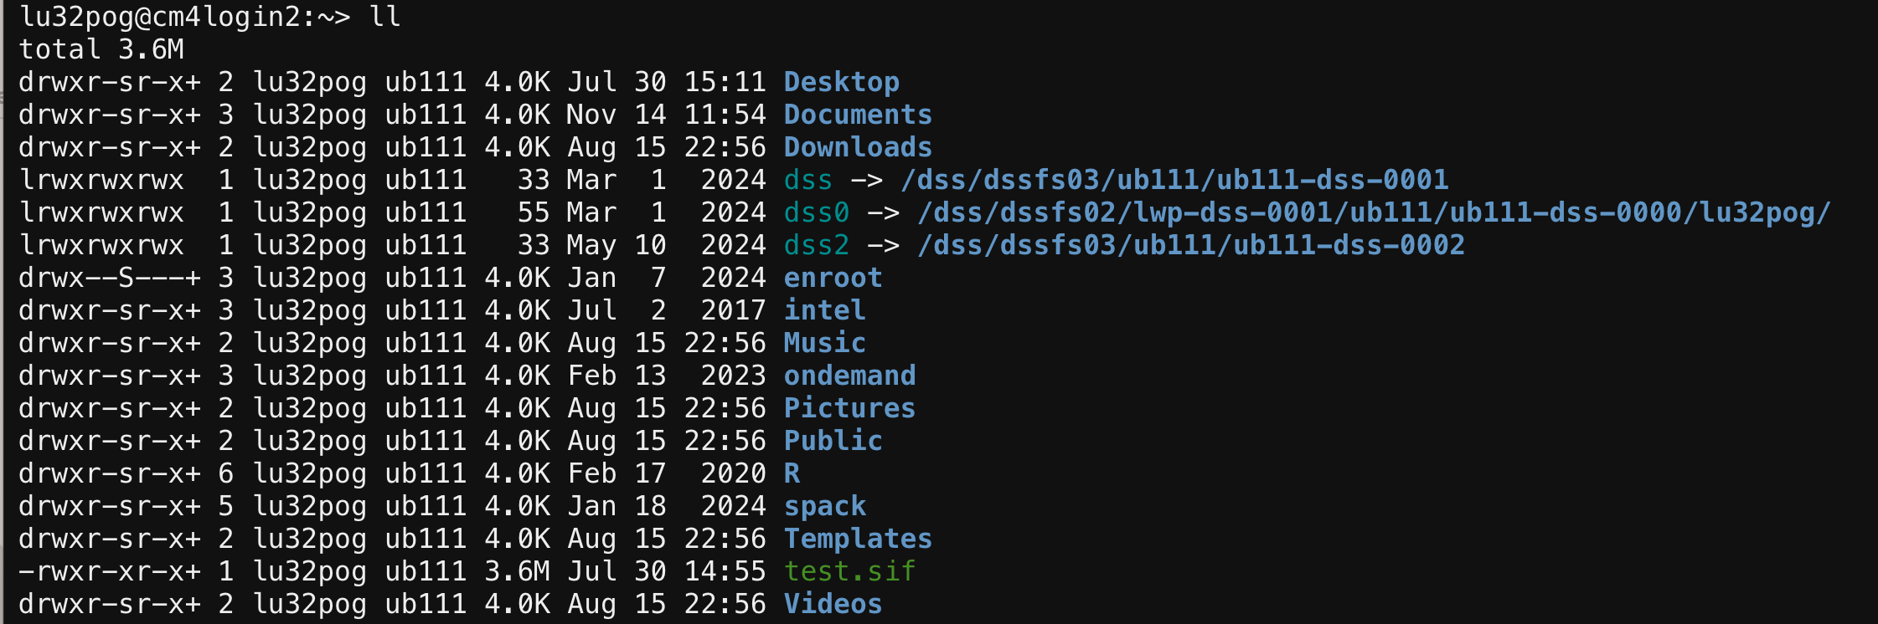
DSS Storage
Automatically attached to linux cluster system (ultrafast)
It can be mapped to the cloud computing (fast)
It can be accessed via Globus (for external collaboration, slow)
Visible for the whole project group

Slide 15
Compute Cloud (OpenStack)
VM Flavors & Features
CPU: From 1 vCPU (lrz.tiny) to 40 vCPUs (lrz.4xlarge)
GPU: nvidia-v100.1 with Tesla V100 16GB GPU
Storage: Block volumes up to 1TiB per user
Network: MWN internal + floating IPs for internet access
https://cc.lrz.de/
Pricing Change: Free operation ended April 1, 2024. Now charged per EUR/year based on allocated resources.
Student Access: Students must be associated with research group projects.

Slide 16
When you need your own CC
Need a dedicated computing system
Imaging software
Own server
Customized environments
No need to allocate computing resources (unlike Linux Cluster)
Run for as long as you need
You need to install everything from scratch

Slide 17
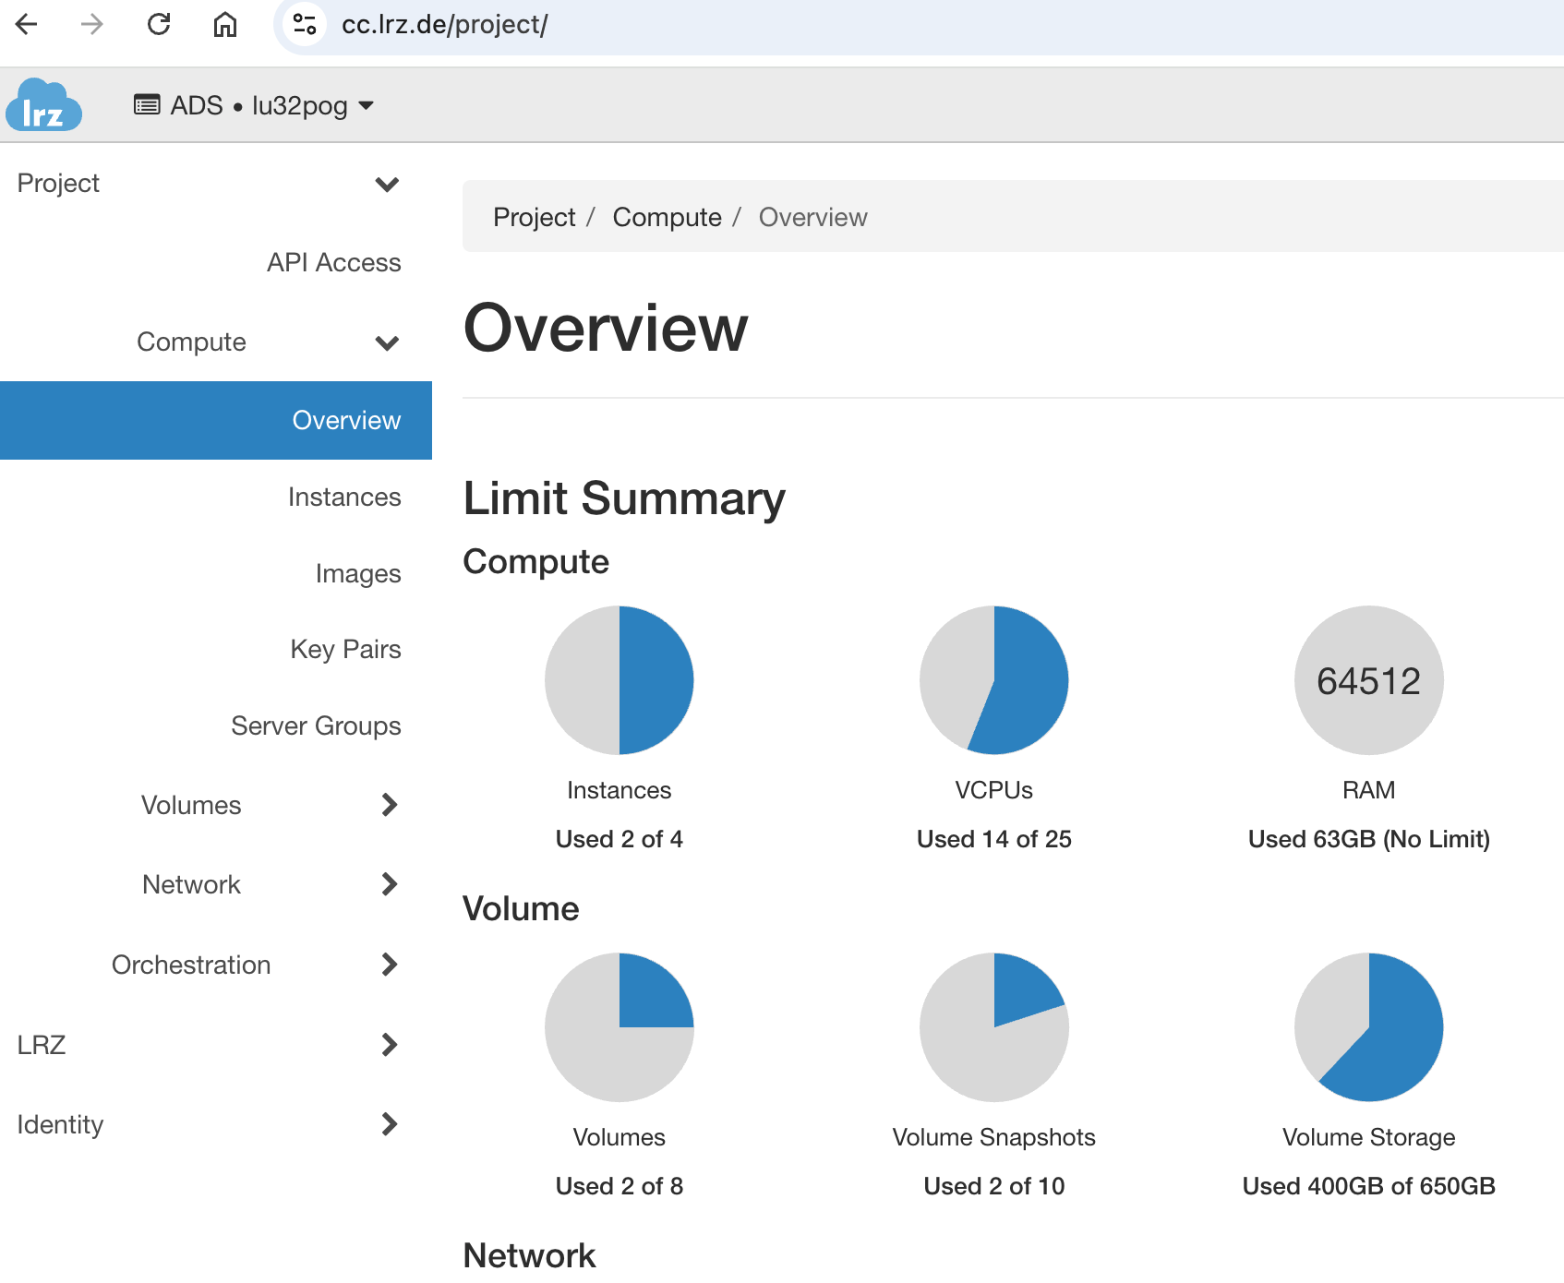
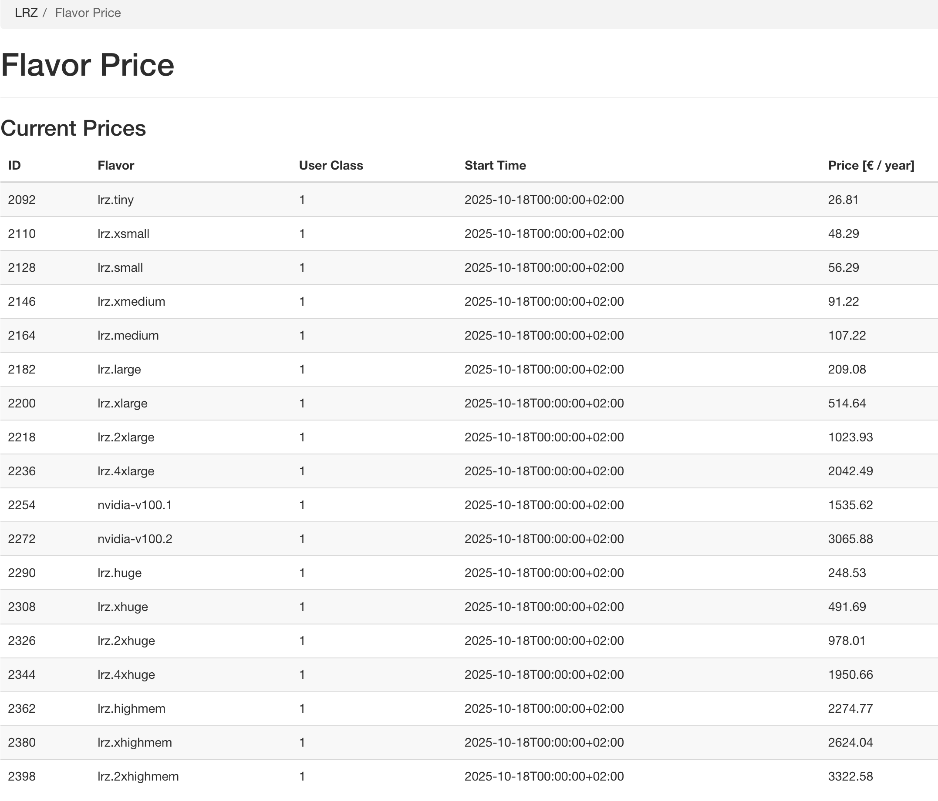
Compute Cloud Backend

Slide 18
MSense Lab Computing Cloud
Customized imaging processing environments
NeuroDesk
NeuroCommand
Collaboration via a remote server
Native to Visual Studio Code
Data access to Data Science Storage (DSS)

Slide 19
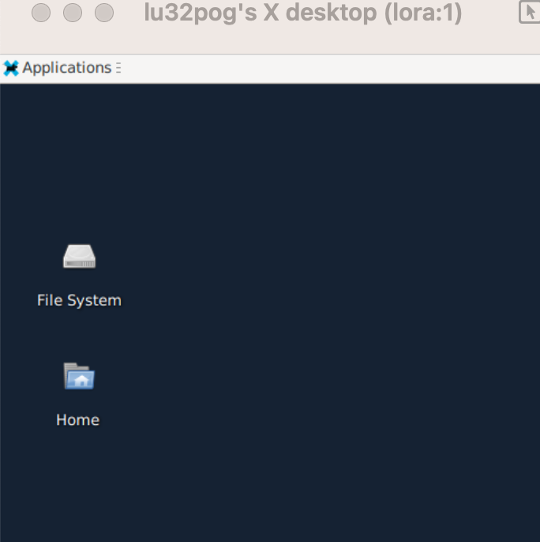
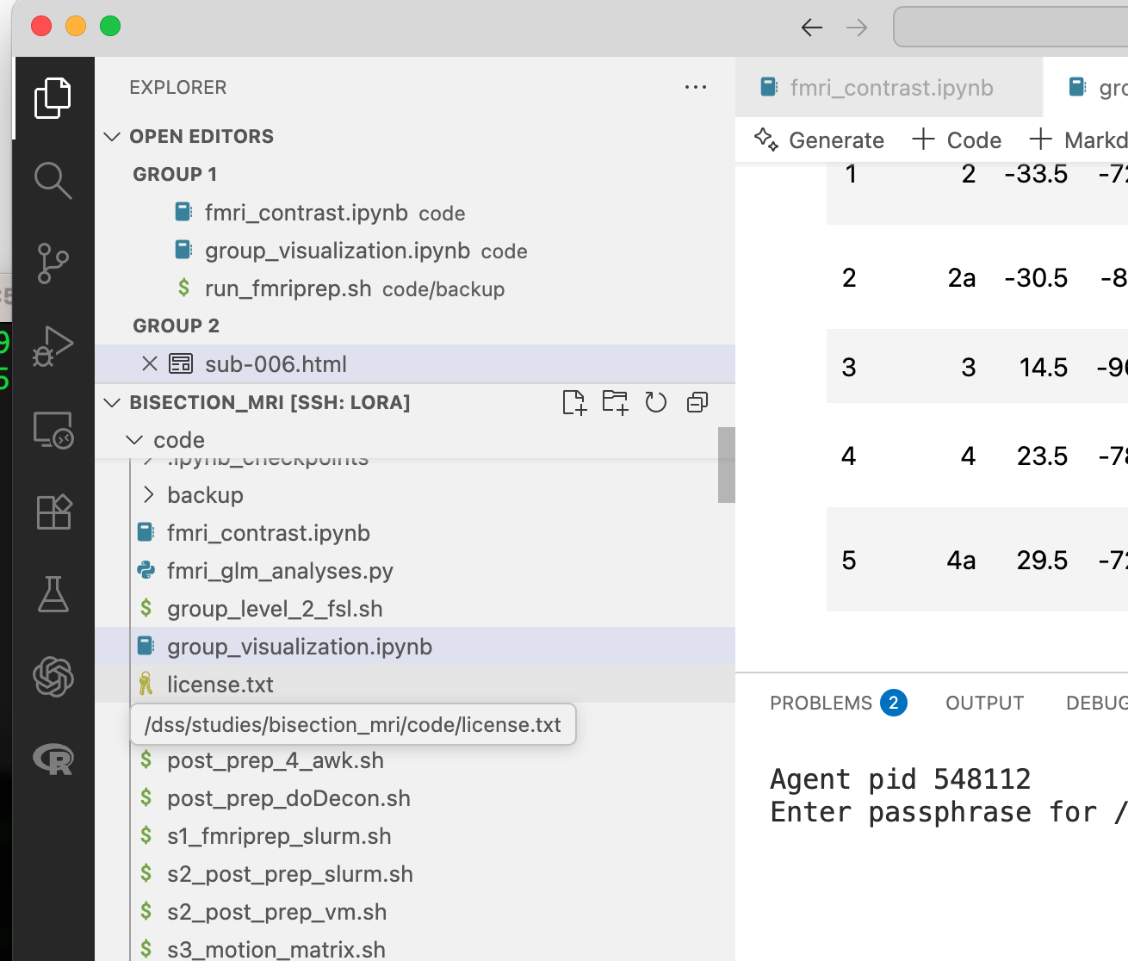
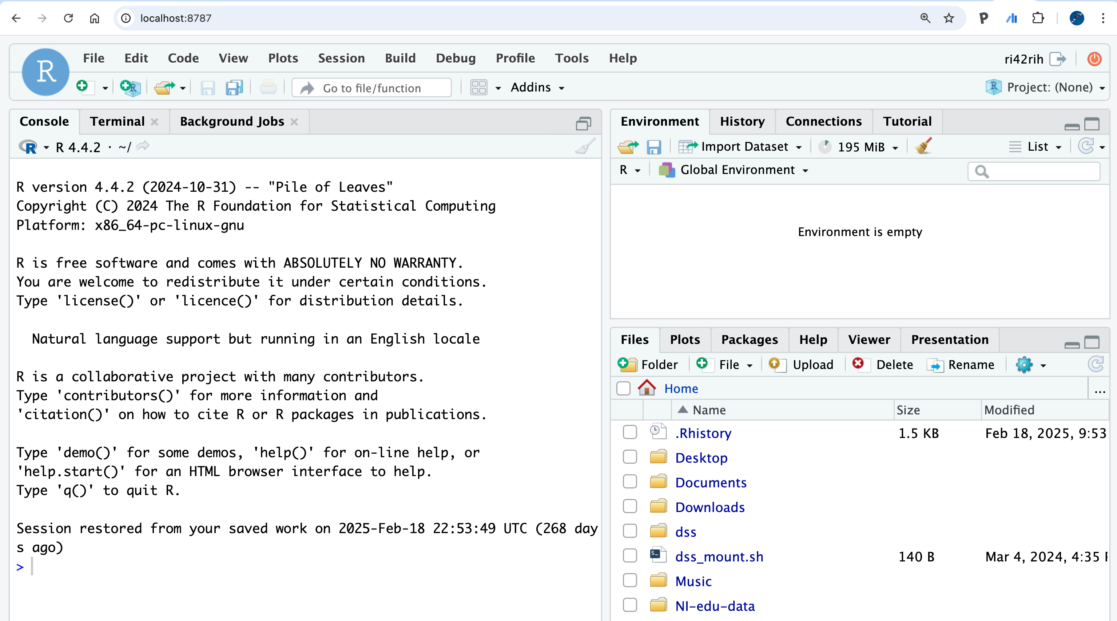
Connections
VNC
VS Code
Web Browser

Slide 20
Collaboration & Development Tools
BayernCollab
GitLab
Atlassian Confluence platform for 133,000 users across 19 Bavarian universities
Version control with CI/CD pipelines
Two instances: gitlab.lrz.de (education) & gitlab-ce.lrz.de (professional)
Wiki, project coordination, meeting docs
Software Licenses
Web & Email
ANSYS, MATLAB, LabVIEW, SPSS, Microsoft Office
PHP web hosting, Exchange email (5GB mailboxes)
Campus and academic licenses
Mailing lists, SSL certificates, databases

Slide 21
Backup & Network Infrastructure
TSM Backup System
125PB total capacity (110PB used) • 150TB added daily
LMU receives 35PB free provision
20 servers, 5 tape robots, 70,000+ slots, 126 drives
10-year archive retention • DFG-compliant
Network Services
eduVPN: Secure VPN access to MWN resources
eduroam: Worldwide WLAN access at participating institutions
MWN: Munich Scientific Network connecting LMU, TUM, and partners

Slide 22
Cost Summary for LMU Users
Service | Free Quota | Cost Status
Personal Cloud Storage | 400GB per user | FREE
Linux Cluster | Unlimited computing time | FREE
SuperMUC-NG | Project-based allocation | FREE
Data Science Storage | 10TB free for projects | FREE / Paid above quota
Compute Cloud | N/A | PAID (since April 2024)
Backup System | 35PB for LMU | FREE
Collaboration Tools | BayernCollab, GitLab, etc. | FREE
Bottom Line: Nearly all core services are FREE for LMU staff and students.
Costs apply to: large institutional storage beyond quotas and cloud computing (since April 2024).

